Slide 1

The MediFusion AI Platform: Revolutionizing Personalized Healthcare
by As his h Pal

Slide 2
Problem Statement
MediFusion AI integrates advanced AI with healthcare to revolutionize personalized care. By predicting symptoms, providing insights, and recommending treatments, workouts, and diets, it empowers users and healthcare professionals with actionable, data-driven decisions.
With key features like easy home blood collection scheduling, automated doctor appointment requests via email, real-time AI chatbot assistance, personalized health insurance plans, and wellness programs like yoga and meditation, MediFusion AI ensures accessible, efficient, and proactive healthcare for all, improving outcomes and reducing costs.

Slide 3

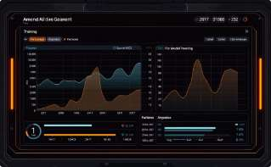
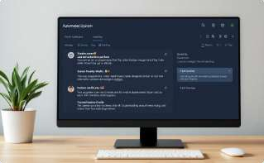

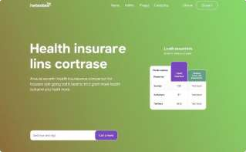
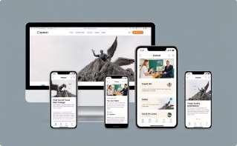
MediFusion AI: Approach
Data Preparation
Clean, preprocess, and analyze health
data for trends and insights.
Model Development
Train ML models for accurate symptom prediction and recommendations.
Automation
Automated blood collection and appointment scheduling with email notifications.
Chatbot Integration
AI chatbot for real-time health support and recommendations.
Health Plans & Wellness
Personalized insurance plans and
wellness programs (yoga, meditation).
Deployment
Web and mobile platforms for
accessibility and scalability.

Slide 4




End Goal: Pioneering the Future of Personalized, Accessible Healthcare
Empowers Individuals
Personalized health insights, symptom predictions, and tailored recommendations enhance well-being.
Enhances Healthcare
Efficiency
Streamlines interactions, automates processes, and optimizes resource allocation for better outcomes.
Promotes Holistic
Health
Integrates yoga, meditation, and lifestyle programs to support both physical and mental well-being.
Fosters Accessibility
Makes healthcare services, like home blood tests and AI chatbots, easily accessible to everyone.

Slide 5
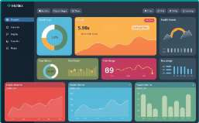
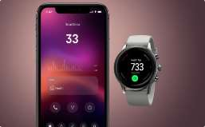




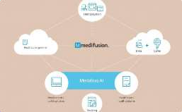
Future Scope of MediFusion AI
Personalized Health Dashboards
Interactive dashboards provide comprehensive health overviews, including personalized insights, trends, and actionable recommendations. Users can easily track their progress towards health goals, access educational resources, and receive timely alerts.
Wearable Device Integration
Seamless integration with wearables such as smartwatches and fitness trackers allows for continuous monitoring of vital signs, activity levels, and sleep patterns. Data is automatically synced with the MediFusion platform for a holistic view of health.
Predictive Analytics
Advanced predictive analytics uses machine learning algorithms to identify potential health risks and provide proactive interventions. This helps in early detection of diseases, personalized preventative care, and improved health outcomes.
Telemedicine & Remote Monitoring
Supports remote monitoring of patients through wearable devices and regular check- ins, enabling timely interventions and reducing the need for frequent in-person visits. Virtual consultations offer convenient access to healthcare professionals.
AI-Driven Health Goals
AI-powered health goals and action plans are personalized based on individual needs and preferences. This approach helps users maintain motivation, track their progress, and stay engaged in their health journey. The system provides reminders and encourages consistent effort.
Holistic Wellness Programs
MediFusion integrates comprehensive wellness programs that focus on all aspects of well-being. These programs include guided meditation sessions, personalized yoga routines, and nutritional guidance tailored to individual needs.
Enhanced Healthcare Integration
MediFusion seamlessly integrates with existing electronic health records (EHR) and other healthcare systems. This enables improved data sharing, reduces redundancy, and streamlines processes for healthcare professionals.

Slide 6
MediFusion AI Platform Architecture
User Inputs Issue
Users enter their health issue or symptoms via the user interface.
AI Prediction
The system analyzes user input and predicts potential causes, recommends medications, and creates a personalized health plan.
Doctor Appointment Booking
Users can schedule appointments with doctors through the platform.
Blood Test Booking
Users can request home blood collection by filling out a form.
Chatbot Assistance
Users can interact with an AI-powered chatbot for additional health information and guidance.
Health Insurance Plan
Users can choose a suitable health insurance plan based on their needs.
Wellness Plan
Users can book wellness services like yoga, stress relief, or meditation sessions.

Slide 7
MediFusion AI: A Staircase to Better Healthcare
Empowered Individuals
Personalized care and proactive health management tools.
1
Enhanced Healthcare Efficiency
Streamlined workflows, reduced costs, and improved data sharing.
2
Improved Healthcare Quality
Better diagnostics, improved patient outcomes, and data-driven insights.
3
Sustainable Healthcare Ecosystem
Reduced costs, improved risk management for insurers.
4
MediFusion AI is a paradigm shift in how we approach healthcare, making personalized and proactive care more accessible.

